Slide 1







GROUP-10 HASINI N N.HARSHITHA TEENA S
MADDU SIRI VARSHINI M.KANIMOZHI HARSHINI
AM.EN.U4ECE22122 AM.EN.U4ECE22123 AM.EN.U4ECE22144 AM.EN.U4ECE22150 AM.EN.U4ECE22157

Slide 2



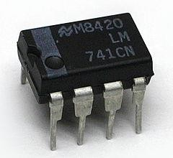

OBJECTIVE:
To design a simple 12V battery charge level indicator using Op-Amp. It indicates different battery levels using LEDS.
Components Required:
4×LM741 OPAMP IC
4×LED Lights
1×2.5kΩ Resistor
5×1kΩ Resistor
1×1.6kΩ Resistor
4×0.5kΩ Resistor
1×10kΩ Resistor
Battery

Slide 3

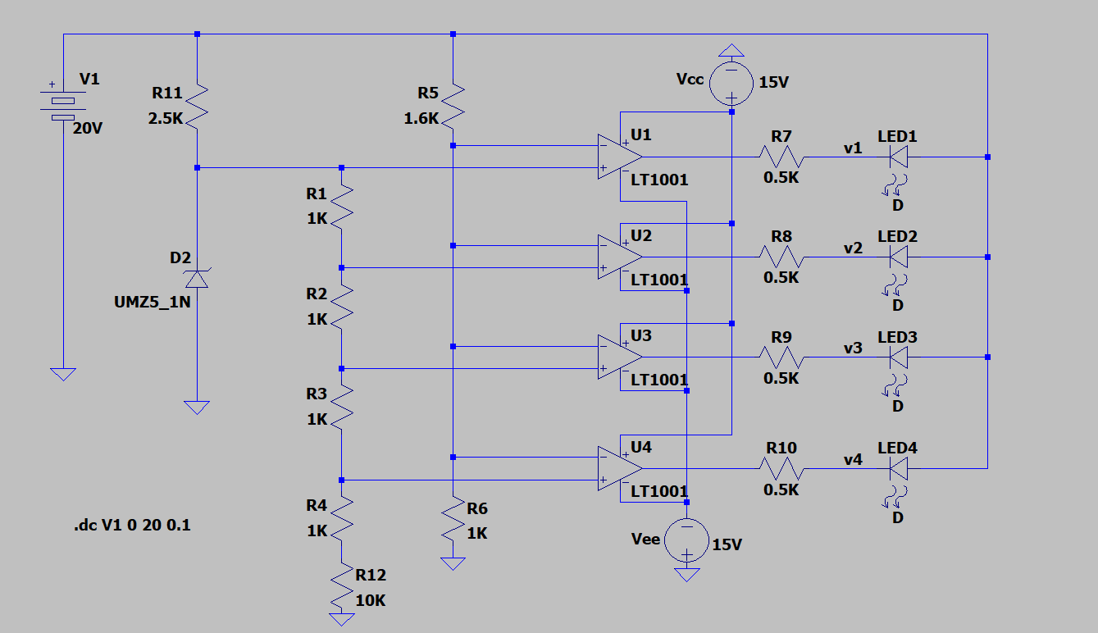













Slide 4
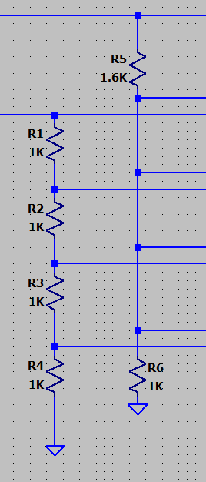


Reference Voltages Section:
Use a 5.1V Zener diode to set reference voltages.
Four 1kΩ resistors create a voltage drop, setting
reference points at 5.1V, 3.75V, 2.5V, and 1.25V.
Battery Voltage Comparison:
Use a voltage divider with 1.6kΩ and 1kΩ resistors to scale down the battery voltage.
Compare scaled battery voltage with reference
voltages using 4×LM741 Op-Amps.

Slide 5
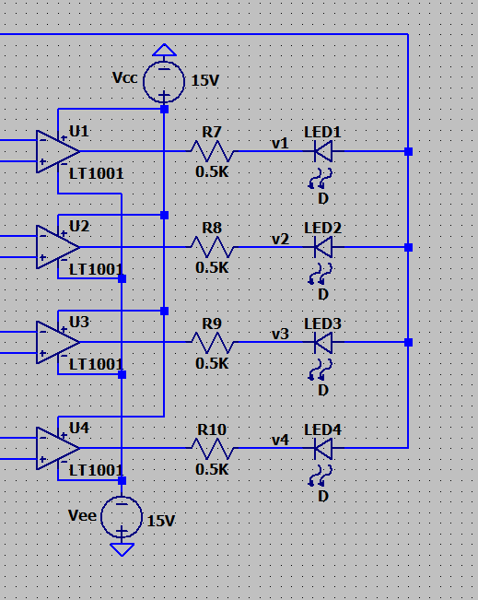





Comparator and LED Section:
OPAMP as comparator.
Non-inverting terminal connected to battery voltage.
Inverting terminal connected to reference voltage.
LED lights up when battery voltage is lower than reference voltage.

Slide 6

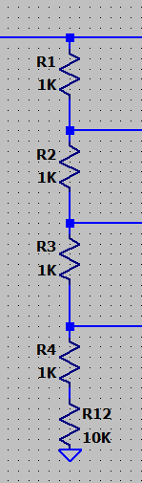



Challenges and Improvements::
Improve accuracy by adding an additional resistor in series with the potential divider across the 5.1V Zener diode.
Allows for finer voltage level detection in smaller ranges.

Slide 7


We designed a simple 12V battery level indicator using the 4×LM741 OpAmp. The circuit, comprising resistors, LEDs, and a Zener diode, effectively shows the battery's charge state with LEDs. This project demonstrates a practical approach to battery monitoring, suitable for applications without complex management systems, and can be easily adapted for different voltage ranges and improved for accuracy.

Slide 8






THANK YOU

